Slide 1
HAWK EYE
-Real Time Tracking Based On Artificial Intelligence

Slide 2
PROBLEM STATEMENT:
To know the coordinates or location of a Person and track him/her on a large scale area. To further implement a solution for problems like escaped convicts,suspects or recognizing a concerned authority within its premises using face recognition to address the issue of encoding and recognition of face sequences that arise from continuous head movement.

Slide 3
Abstract
At the first the source feed from all the input camera’s is stabilized and enhanced using Machine Learning Algorithms implemented via VidStab and OpenCV. The stabilized feed is passed through our face recognition algorithm and is validated across our database.A unique technique of “One Shot Learning” is implemented via Siamese neural network along with some popular deep learning frameworks like Dlib,keras and TensorFlow. If the match accuracy of any image across the database is found to be greater than 90%,then frame of the feed is captured and coordinates of that particular camera are sent to the web application through the server. This information is appended to the information database for further reference .We used WSGI production server for developing our web application and MYSQL for the databases.

Slide 4
CHALLENGES:
To stabilize the noisy camera feed to a highly stable and enhanced feed
To extend the working algorithm to multiple working feeds
To reduce the size of the input training images
To reduce the runtime of the algorithm
To provide stable and efficient output

Slide 5
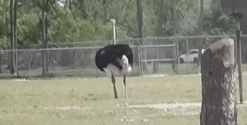
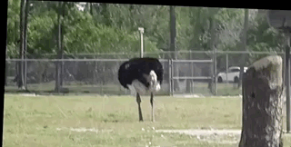
STABILIZED DEMO
xss
BEFORE AFTER

Slide 6

User Interface

Slide 7


Slide 8

Result

